Slide 1
IMAGE PROCESSING
PROJECT
Improved Chicken Swarm Optimization for contrast enhancement of handwritten documents

Slide 2
INTRODUCTION
In this project , we try to learn the preprocessing of handwritten document by contrast enhancement while preserving details using an improved chicken swarm optimization algorithm.
Preprocessing steps aim to mitigate noise and enhance accuracy, with contrast enhancement being a fundamental procedure.
Image enhancement involves improving the visual quality of images to make them look better and more suitable to use for a particular task by reducing noise. In the spatial domain, adjustments are made to the pixel values to achieve the desired enhancement. This adjustment is typically expressed through a mapping function:
g(m,n)=T[f(m,n)] (1)

Slide 3
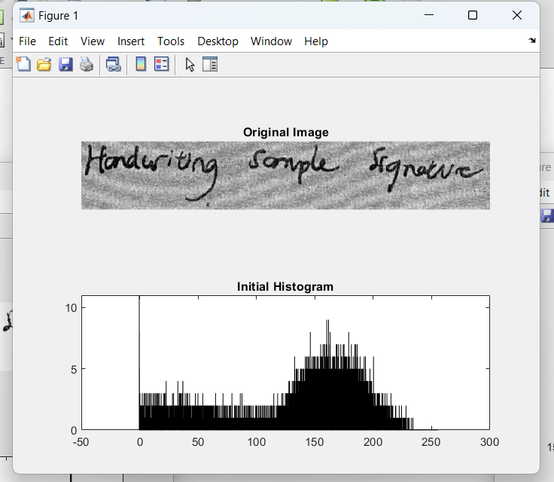
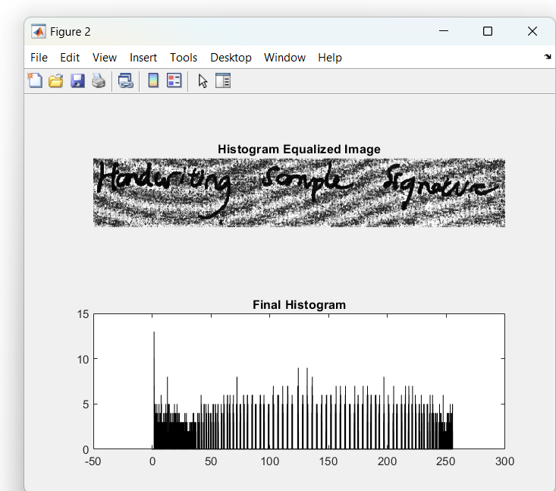

Slide 4
HE gives a flat histogram of an image which may not be exactly uniform because of the discrete nature of the pixel intensities. This results into significant change in the brightness.
The histogram equalization brings large changes to the intensity level values in the image as compared to the original less contrasted image ,thus we need to look into histogram modification techniques which provide us an intermediate histogram which is closer to the original histogram and also to the high contrasted uniform histogram.
HISTOGRAM MODIFICATION:
Min||h-h_{i}||+λ||h-u||
λ ∈ [0,∞) is a problem parameter if λ = 0 the Histogram obtained corresponds to the traditional HE and as λ tends to ∞ , it converges to the original image. Thus through varying λ different levels of contrast can be obtained.

Slide 5
2) ADJUSTABLE HISTOGRAM EQUALIZATION:
To solve the optimization problem stated before slide, we use the sum of squared differences between histograms.
h=argmin_{h}||h-h_{i}||²₂+λ||h-u||²₂
3) HISTOGRAM SMOOTHING:
While Adjustable Histogram Equalization improves contrast, it also introduces spikes in homogeneous regions of the image. To solve this, we introduce a smoothness constraint to the optimization problem.
min(||h-h_{i}||²₂+λ ||h-u||²₂+γ ||Dh||²₂)

Slide 6
Improved Chicken Swarm Optimization and its
application in Image Enhancement
The the chicken swarm optimization algorithm(CSO) is a metaheuristic algorithm which which uses the hierarchical foraging behavior of chicken to find the optimal value of a given objective function.
Here we consider there some population of hen let it be N, and this population is divided into groups with each group having dominant male roosters, hens and chicks.
Each chicken has a fitness value which is actually the value of our objective function
And the chickens are classified into roosters,hens , and chicks on the basis of optimality (maximum or minimum as the case may be)of the fitness function value where the chickens with most optimal fitness values are chosen as roosters and they lead a group, chicken with worst values as chicks and the rest as hens.

Slide 7
Hens can lay eggs but not all hens would hatch their eggs simultaneously. The relationship between chicks and the hens in a group also known as mother-child relationship is randomly established.
The hierarchy order, domination relations and mother-child relationship will be unchanged once established, And only updates after every(G) generation.
RN, HN, CN and MN indicate the number of the roosters, the hens, the chicks and the mother hens, respectively.
Formulae we will be using:-
i) The position of the rooster is updated as follows: x^{t+1} _{i,j} = x^{t} _{i,j} + Randn(0, σ2) ∗ x^{t} _{i,j},where
σ2 = 1 if fi ≤ fk .
= exp( (f_{k}−f_{i} )/(|fi|+ϵ) , otherwise (k is randomly generated index of any other rooster

Slide 8
ii) The position of hens are updated as:-
x^{t+1} _{i,j} = x^{t} _{i,j} + S1∗Rand∗(x^{t}_{r1,j} − x^{t} _{i,j} ) + S2∗Rand∗(x^{t} _{r2,j} − x^{t} _{i,j} )
S1 = exp((f_{i} − f_{r1})) / abs(f_{i}) + ϵ)
S2 = exp((f_{r2} − f_{i})) where r1 is the rooster in the ith hen’s group and r2 represent any hen other
than r1
iii) The position of chickens is updated as :
x^{t+1} _{i,j} = s ∗ x^{t} _{i,j} + F L ∗ (x^{t} _{m,j} − x^{t} _{i,j} ) + F ∗ (x^{t} _{r,j} − x^{t} _{i,j} )
where s = self learning factor, F L is a parameter which indicates that a chick would follow
its mother in foraging for food and F is a learning factor, indicating that the chicks would
also follow the rooster in search for food.

Slide 9
First let us see how we would find the optimal value of modified histogram h from
initial histogram h_{i}:-
Step 1:- Take initial value of of N (no of chickens) and define other parameters like
RN,HN,CN, MN,G,maximum number of iterations itermax, etc.
Step 2 :- Initialize the lower bound lu and upper bound up using the gray levels of the
image.
Step 3 :- Generate a population x = (x1, x2, ...xN ) of N chickens with random solutions.
(these actually represent N possible solutions for aur modified histogram)
Step 4 :- Evaluate the fitness(xi) and find the best solution xbest of the chicken swarm,i.e,
the histogram with least value of the optimization function (fitness value).
Step 5:- Then we start a loop for itermax times
Step 6 :- In each iteration we sort the x (set of possible histograms) on the basis of fitness value.

Slide 10
-> sort the x (set of possible histograms) on the basis of fitness value, and mark the first RN histograms with best fitness value as roosters , next HN as hens and last CN as chicks .
-> determine the relationship between the chicks and their mother hens in a group
Step 8 :- For every iteration every chicken in the swarm ,update the positions (the histograms ) depending on their category (rooster,hen or chick) and current fitness value and evaluate their fitness function value.
Step 9 :- For each iteration find out the best fitness value and the corresponding histogram and put it in xbest .
Step 10 :- After all the iterations the final value of histogram in xbest is our resultant optimized modified histogram.

Slide 11
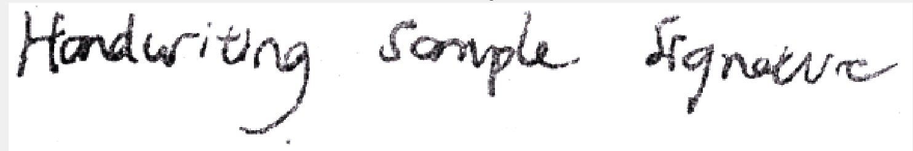
Now let us see how we implemented it :-
We took the input image , got its histogram and applied the ICSO algorithm on it using appropriate value of contrast parameter λ and smoothness constant 𝛾 . Our objective fitness function would be the minimization equation discussed before.
Then we used the resultant modified histogram for “histogram Equalization” and the image to get the final optimized contrast enhanced image.
We also calculated the mean value,standard deviation,entropy and psnr of our output image.

Slide 12
Result and Discussion :-
We can found that the value of G greatly affects the convergence rate of the ICSO algorithm. If its large,the ICSO algorithm would take a longer time to converge to a global best solution (i.e. then N needs to be large) and if it was too small, the quality of the image was not good. For this experimentation, G=10 was considered to yield good results in a comparatively less time.
The Value of λ, the amount of contrast is usually varied on the scale 0-20 and the amount of detail in the image to be retained γ is adjusted on a scale 1000 − 10⁹.
We have taken λ = 4 and γ = 50000 . More the value of λ more is the contrast and more is γ , more the image is smoothened.

